Slide 1

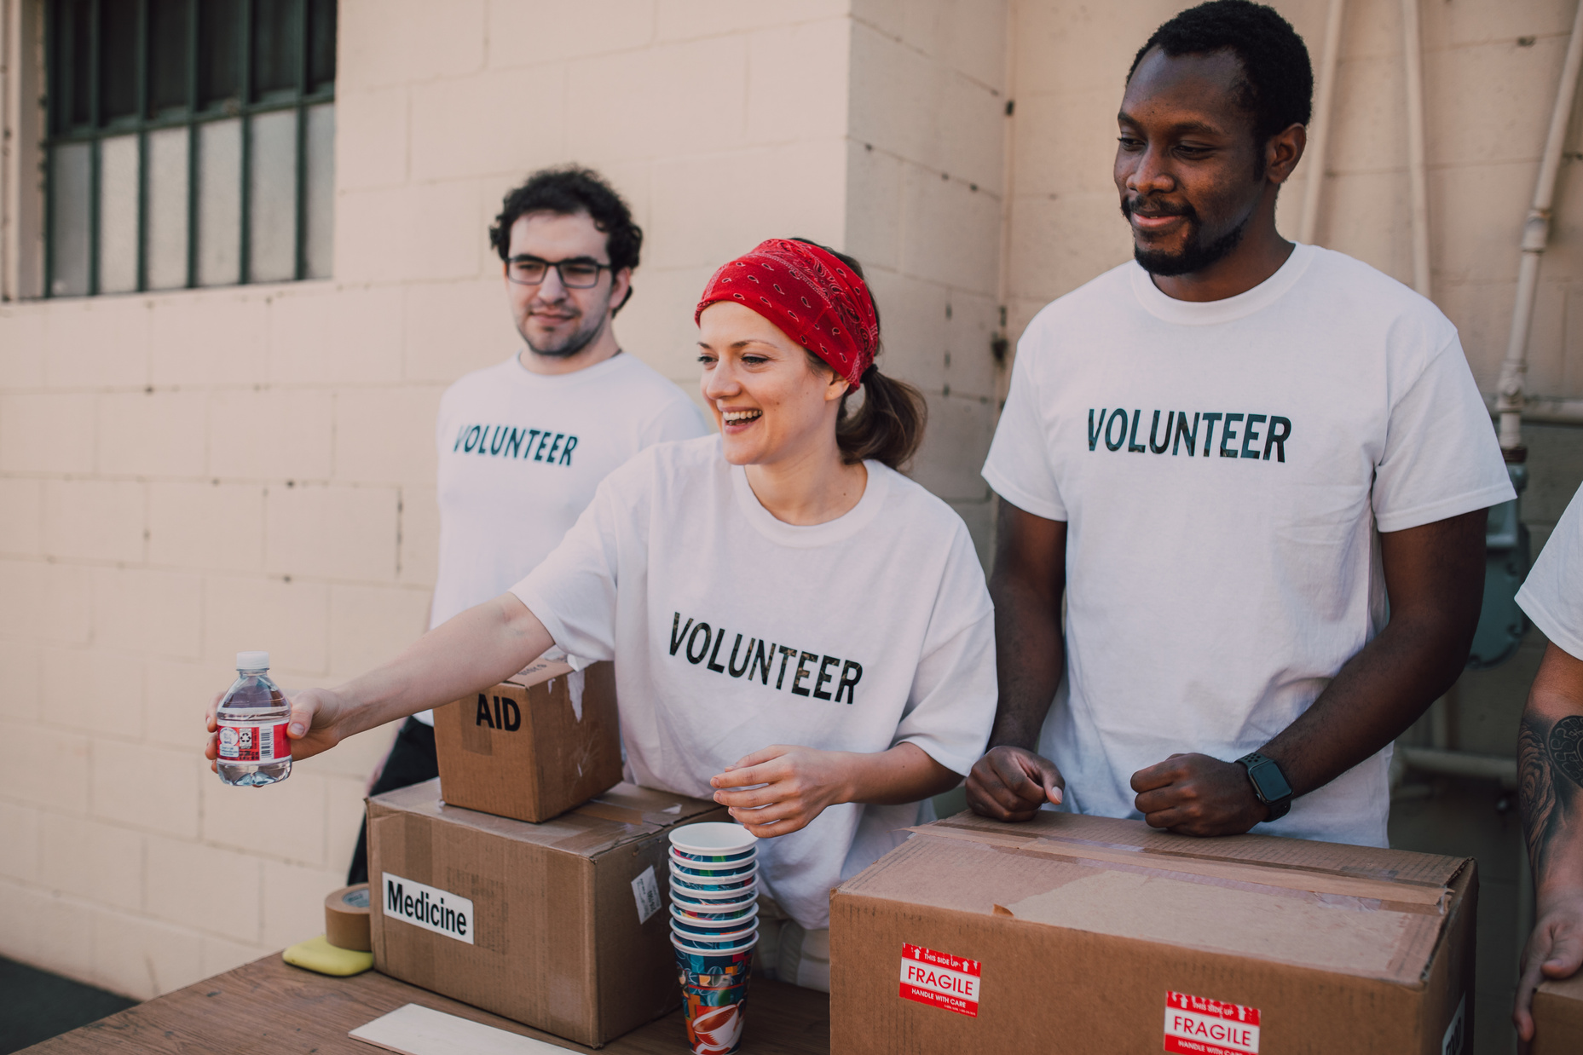

FUNDRAISE APP

Slide 2

TEAM MEMBERS
01
04
Pragdeesh K J
Yuvashree S
02
05
Rishi Mohan Jha
Asmithaa A
03
Kishore R

Slide 3


ABOUT
Our fundraising app is a platform that connects passionate individuals with meaningful causes, making it easy to support those in need and make a positive impact in the community. With a user-friendly interface, users can browse through various fundraising campaigns, donate securely and track progress in real-time.

Slide 4
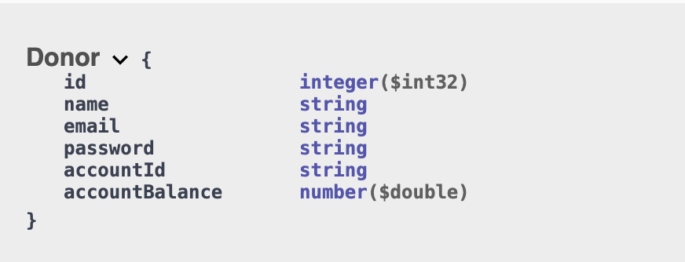
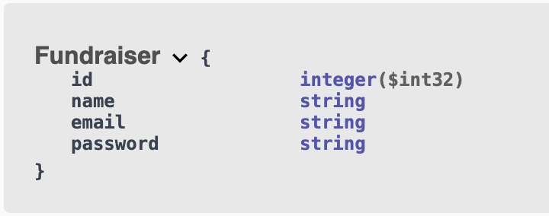
SCHEMAS

Slide 5
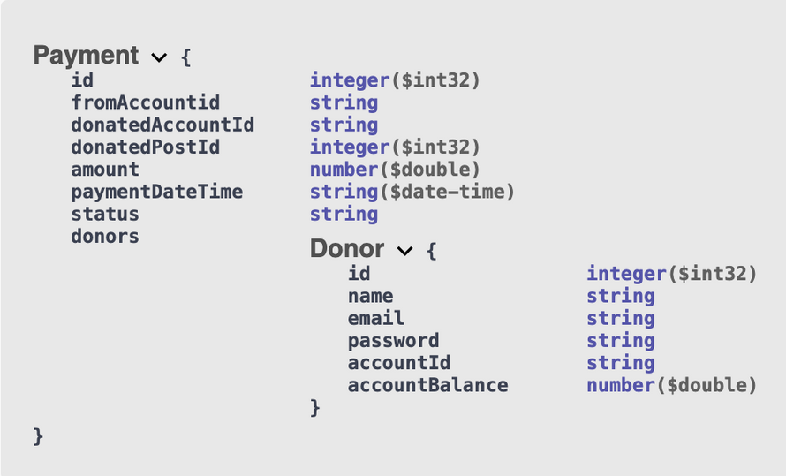
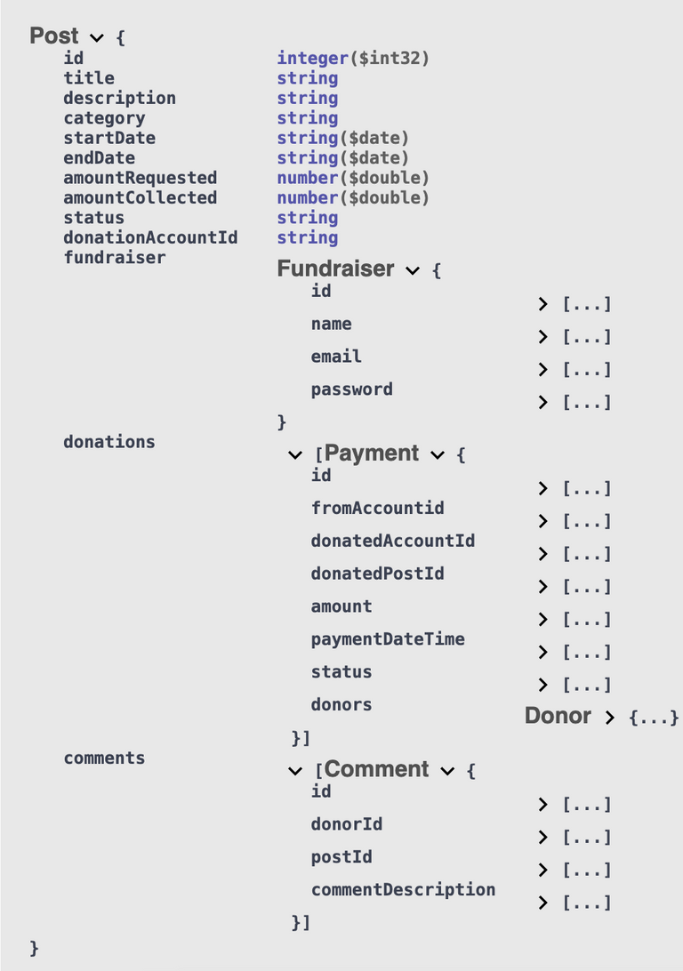
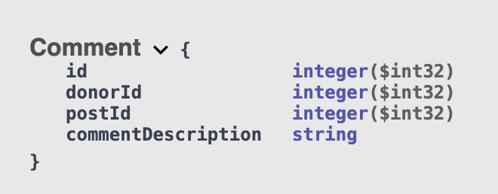

Slide 6
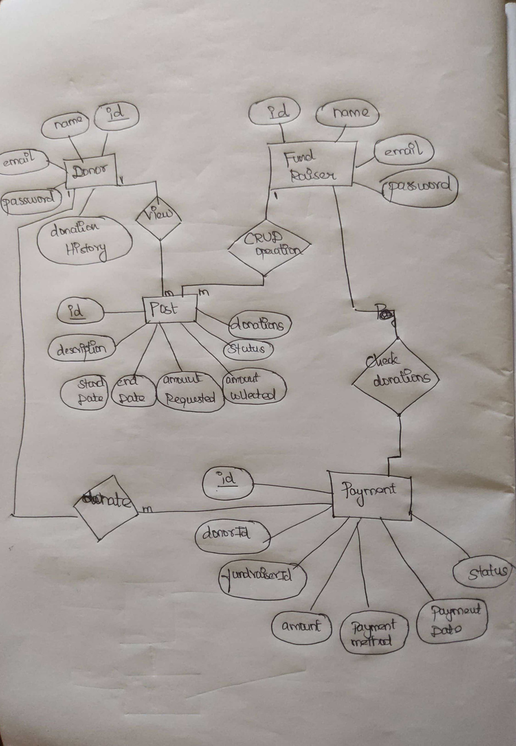
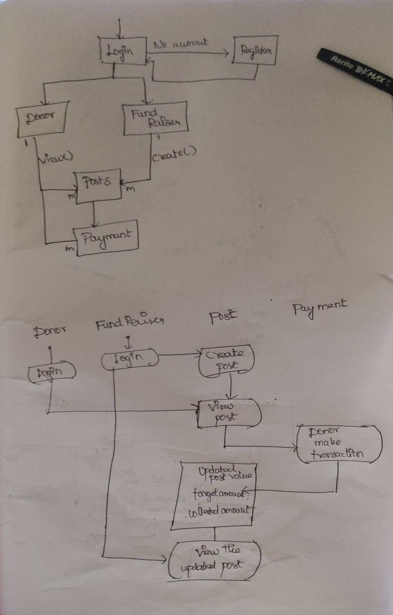
CLASS DIAGRAM

Slide 7

THANK YOU

